Slide 1



My Portfolio
Author: Elamath S
Created with Pi

Slide 2

CONTENTS
1. About Me
2. Education
3. Skills
4. Projects
5. Contact
6. Footer

Slide 3

01
About Me

Slide 4

About Me
Hello! My name is Elamathi. I am currently pursuing B.Sc. Computer Science at GOVT ART AND SCIENCE COLLEGE ANTHIYUR. I am passionate about web development, programming, and learning new technologies.

Slide 5

02
Education

Slide 6
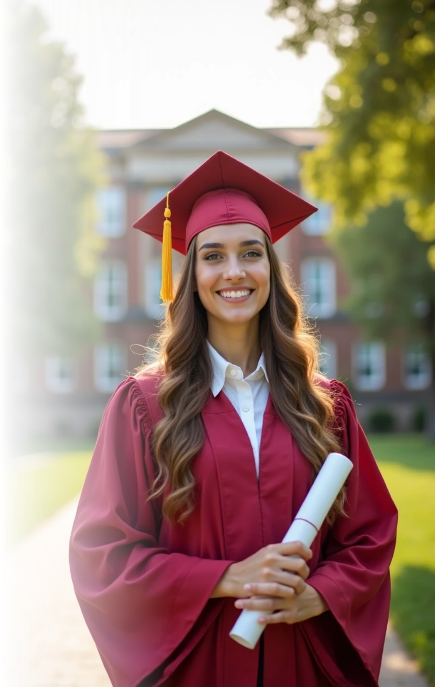
Education
B.Sc. Computer Science: Government Arts and Science College Anthiyur
Secondary Education: Government Girl Highest Secondary School Anthiyur
11th Mark: 307, 12th Mark: 331

Slide 7

03
Skills

Slide 8

Skills
HTML, CSS, JavaScript

Slide 9

04
Projects

Slide 10

Projects
Portfolio Website

Slide 11

05
Contact

Slide 12

Contact
Email: elamathiemail@example.com
Phone: +91 6383631522

Slide 13

06
Footer

Slide 14

Footer
© 2025 My Portfolio | All Rights Reserved

Slide 15

Thank You

